Slide 1
Buchanan, Michigan St. Joe River Public Access and Shoreline Restoration Project

Slide 2
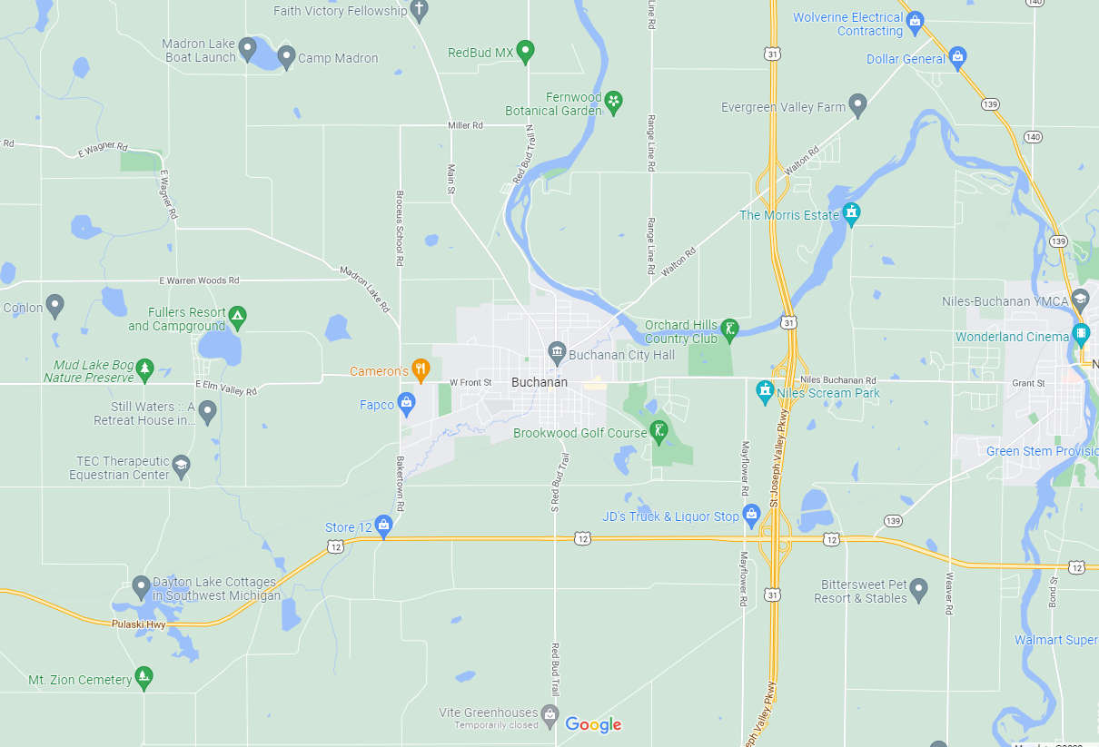

Slide 3
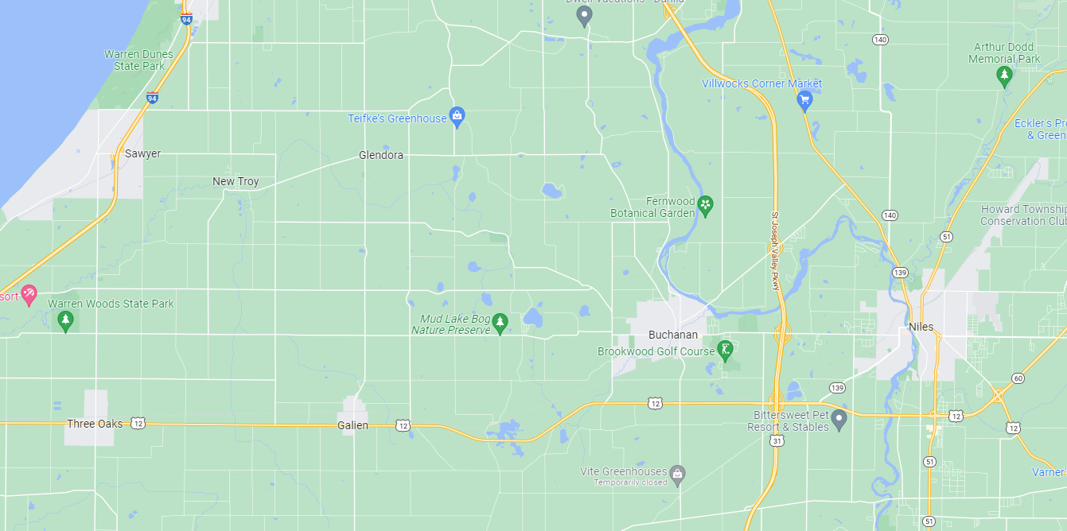

Slide 4
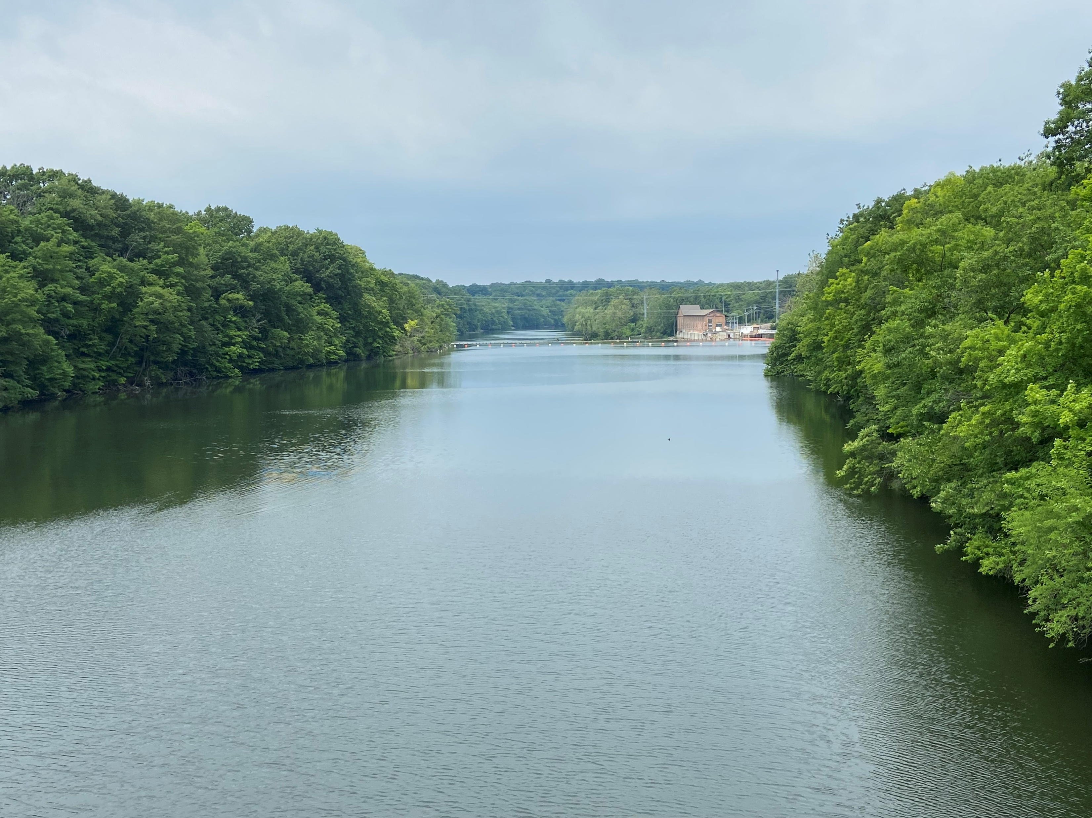

Slide 5
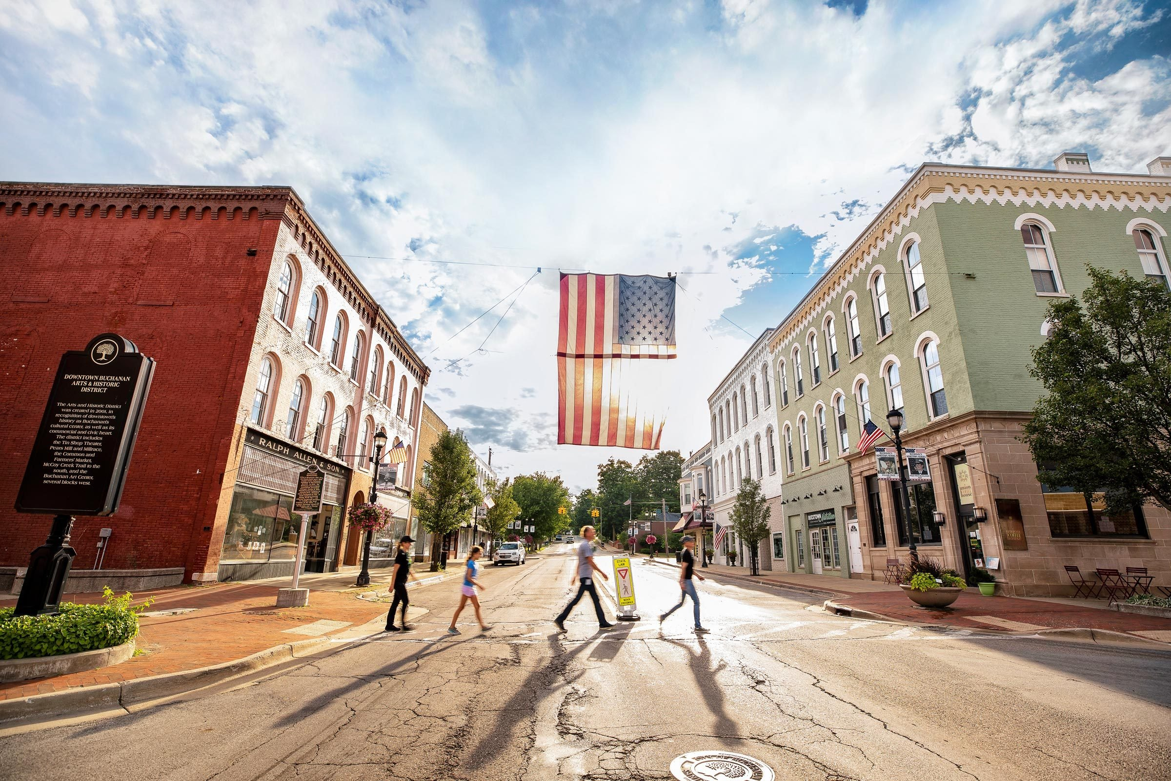

Slide 6
History
The reason Buchanan exists is Water
Potawatami people lived along this river 1000 years ago
Buchanan as a Mill Town
Clark Manufacturing
Lost connections to the water
Now Buchanan is amidst a wave of revitalization

Slide 7
Great Opportunity

Slide 8
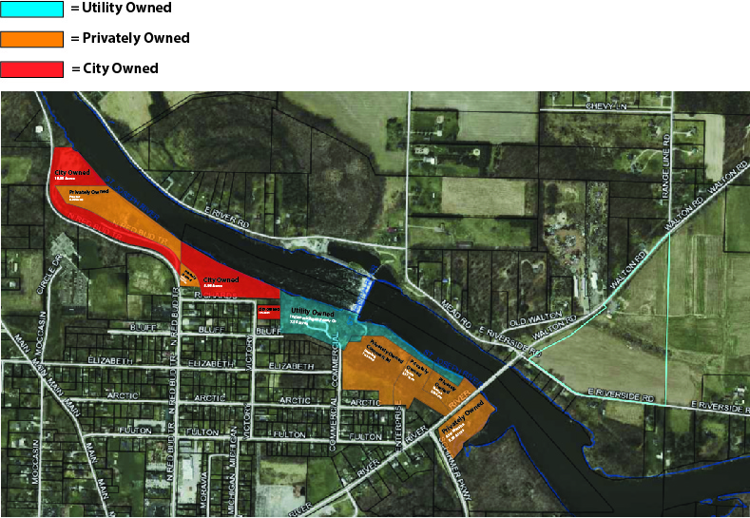

Slide 9
City owned Riverfront Park
20 acres
Public access
0.3 mile access road is washing out

Slide 10
Flora and fauna
Native ecology
Fish species, Walleye, Largemouth Bass, Smallmouth Bass, Brown Trout, Rainbow Trout (including both Steelhead and Skamania), King Salmon, Coho Salmon, Catfish, Drum (Sheepshead), all sorts of panfish
Wildlife, birds, Sand Crane, Bald Eagle, Deer, Beaver, Mink, Osprey, Great Blue Heron, Kingfisher, Swans, Geese, all variety of Ducks including Wood Ducks.
Muskrats, Beaver, Otters, Various turtle species, a bunch of different Snake species, Crawdads.
McCoy’s Creek designated trout stream that runs from St. Joe River actually through our historic downtown

Slide 11
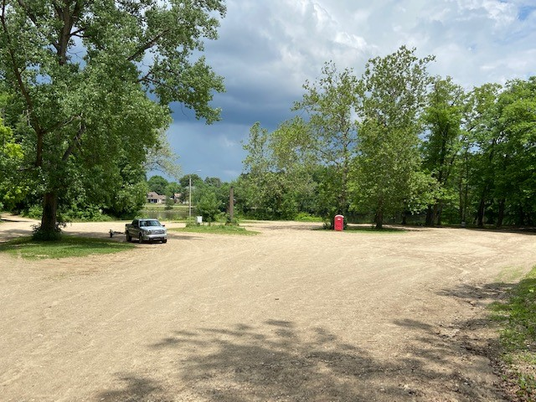

Slide 12
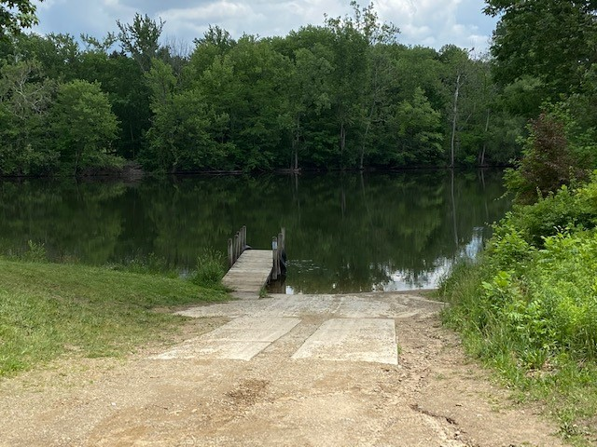

Slide 13
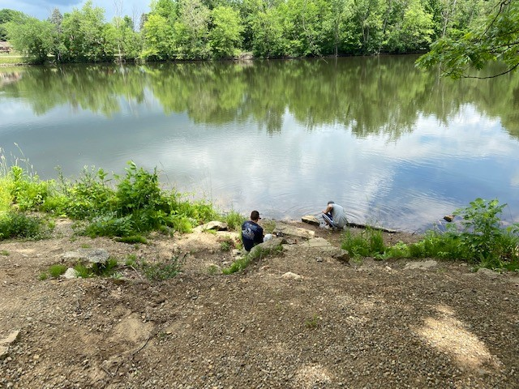

Slide 14
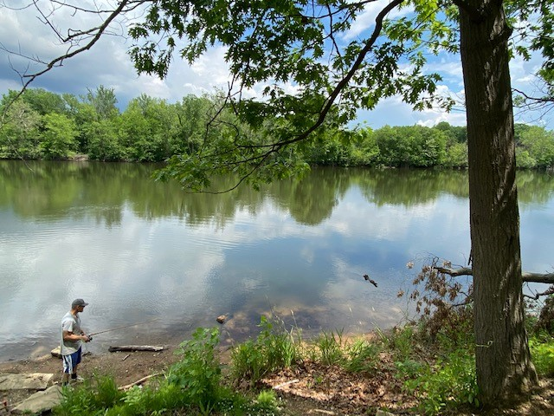

Slide 15
Context
St. Joe river could probably be regarded as one of the most unexploited waterways in interior Michigan.
Buchanan has approximately 50 acres of land on the shore of the river, which could be used for public access, ecological restoration due to damaged and eroded shoreline. The city plans on having a shoreline buffer, invasive removal and erosion remediation along with public access and recreational facilities.

Slide 16
Access is severely threatened
0.3 mile access road that takes you down to the river public access is in threat of total failure.

Slide 17
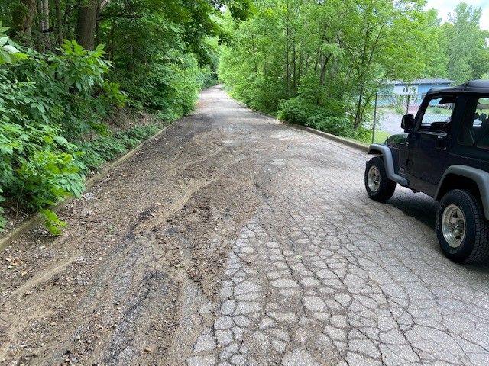

Slide 18
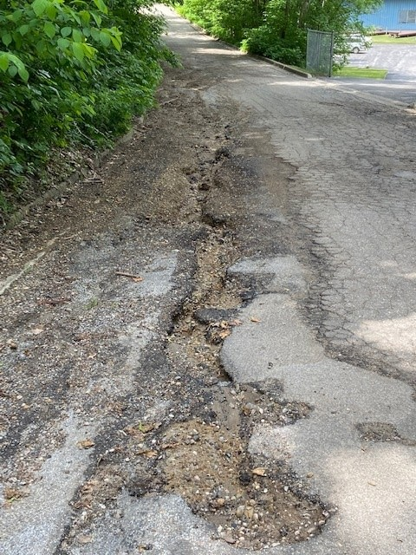

Slide 19
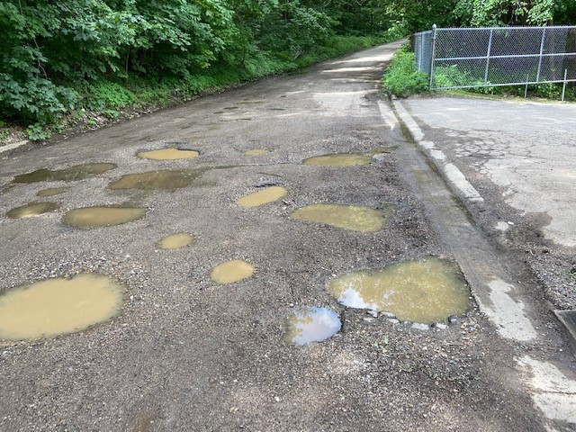

Slide 20
Public Access is Paramount
Maintaining sustainable public access on this road is paramount

Slide 21
Shoreline Stabilization
Shoreline stabilization as the area under consideration comes under the floodplain, Wetland(?), Invasive species (if any, we will need an ecologist to tell us which ones are to be removed), If we treat the erosion and runoff issues, we’ll be able to have a positive impact on the water quality.

Slide 22
Project Goals
Protect, enhance, or restore natural features of wetlands, estuaries, as well as hydrologically connectedstreams and buffer zones. To make sure that self-sufficient biological communities are supported. Enhance, diversify, or increase fish habitat for various life stages of native, threatened and endangered species.

Slide 23
Project Goals
Protect, conserve, and restore critical habitat, including nearshore shallow water habitat for native,threatened and endangered species. Stabilize shorelines to reduce erosion and improve habitat connectivity using nature-based solutions.

Slide 24
Project Goals
Additional goals: To increase public access and public engagement to promote sustainable practices ofecological conservation and human-nature interaction. (Getting more people can be an educational goal as well, signages, boardwalks, a trail on the basis of Indiana Dunes National Park to promote the same, Identifying species of native flora and fauna)

Slide 25
Long Term Vision
To assemble a 50 acres “Buchanan Mini National Park Master Plan” that is accessible to the public on Buchanan’s northern banks of the St. Joseph River while employing shoreline stabilization methods, best practices in nature based solution, while allowing for best practice public access, universal access, that allows for residents to interact with these special natural resources.

Slide 27
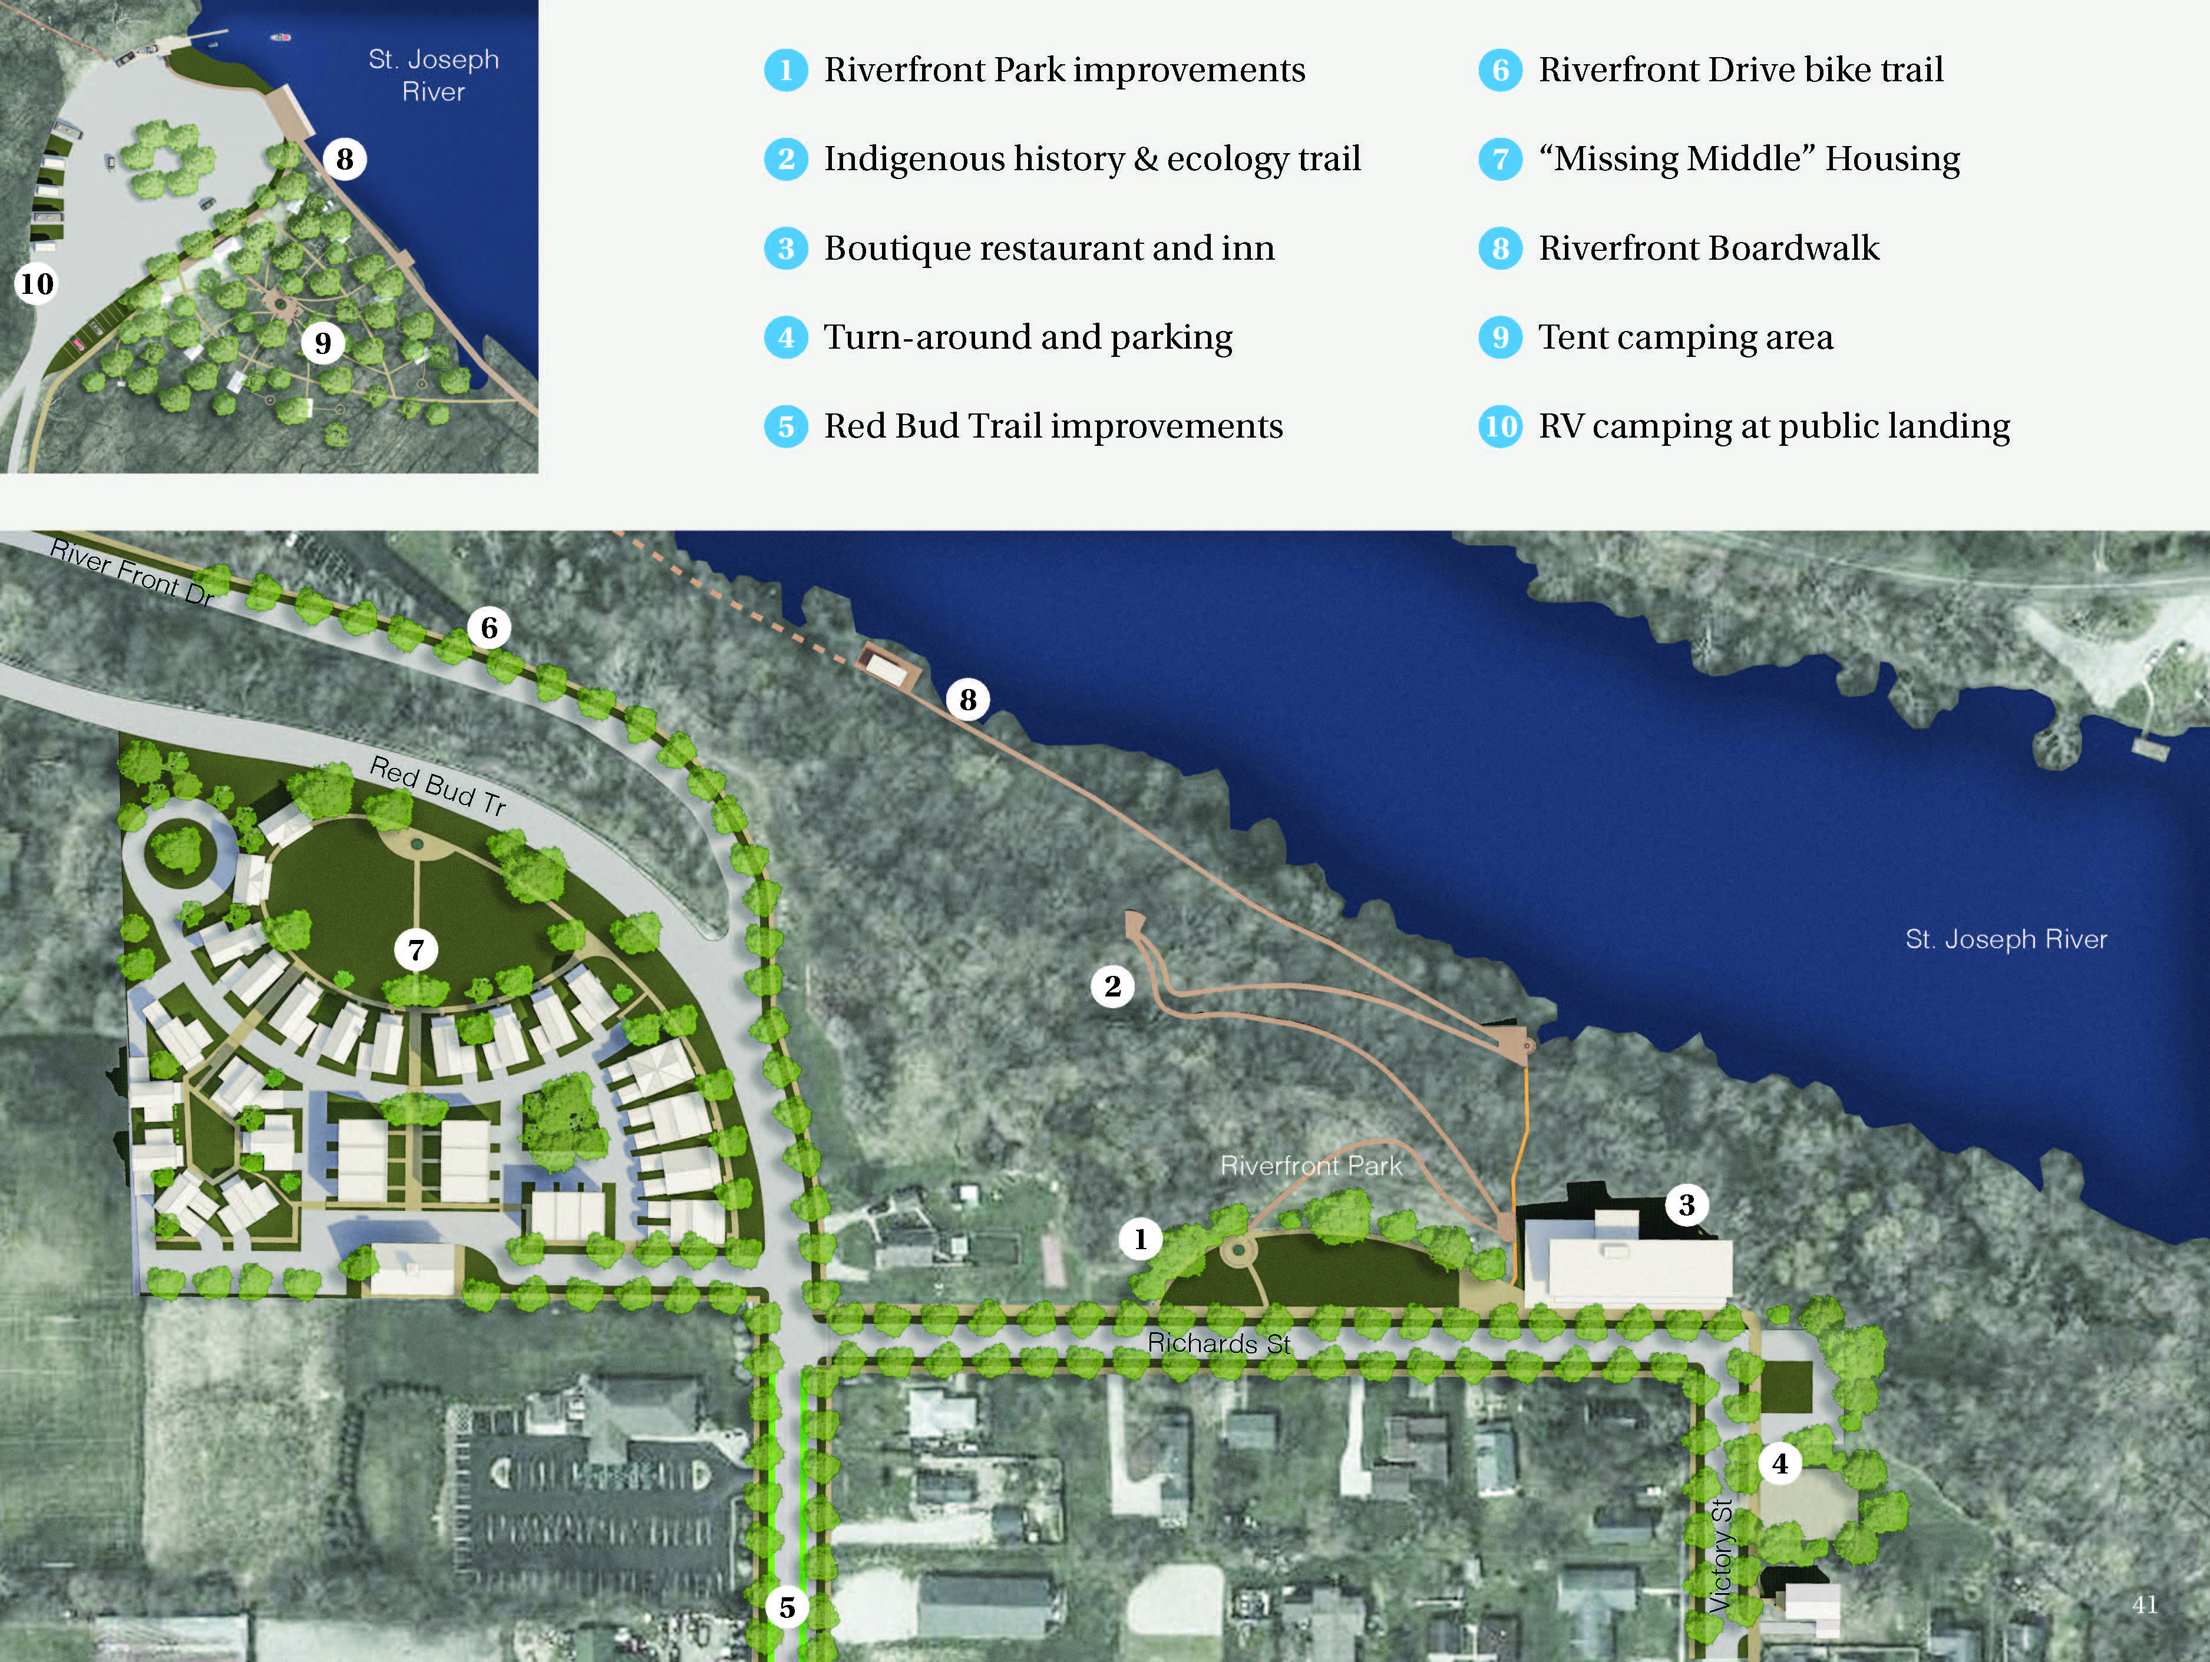

Slide 29
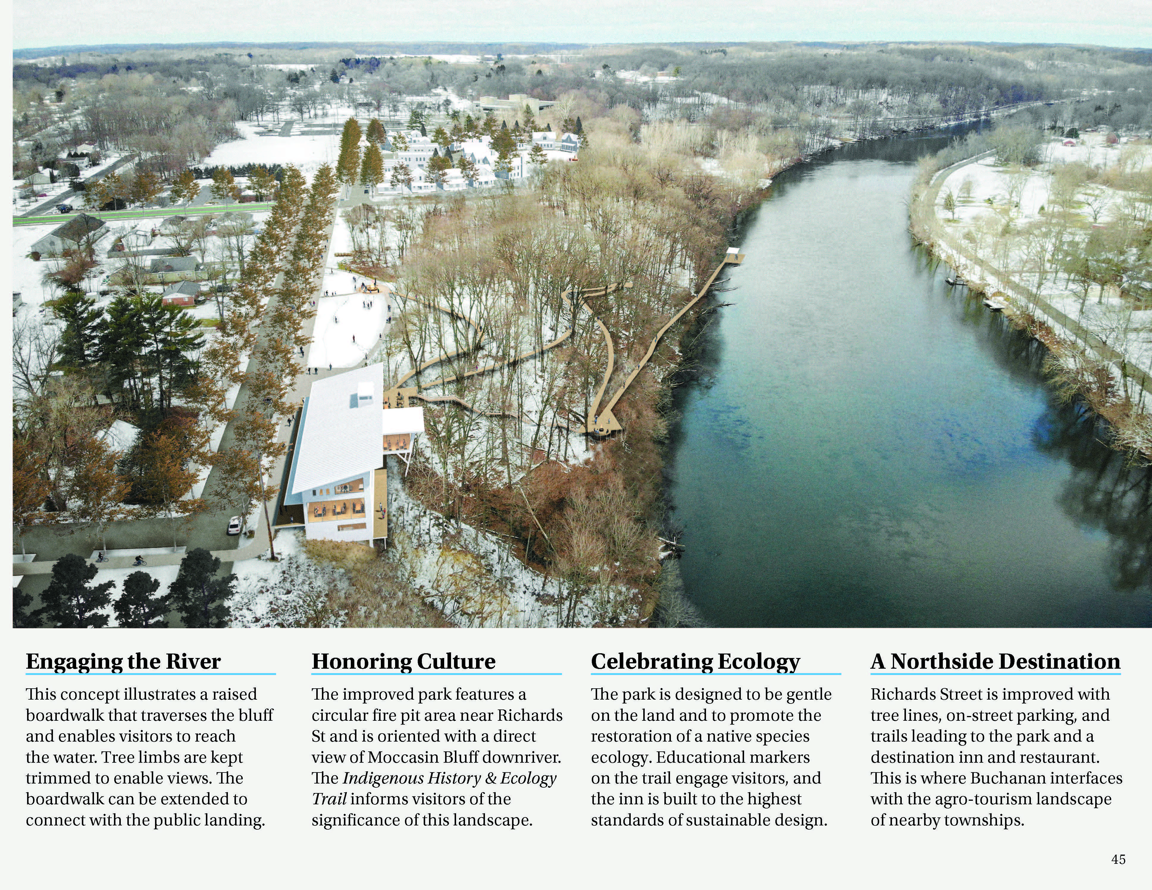

Slide 30
