Slide 1
St. Joseph River Waterfront Master Plan
Community Workshop – October 24, 2023

Slide 2
Agenda
Welcome
Workshop Purpose
Review Master Plan Process
Highlight the key guiding principals we used for design
Conceptual Plan Review and Discussion
Next Steps
ST. JOSEPH RIVER
MASTER PLAN
COMMUNITY WORKSHOP
Buchanan City Hall, 302 N. Redbud Trail

Slide 3
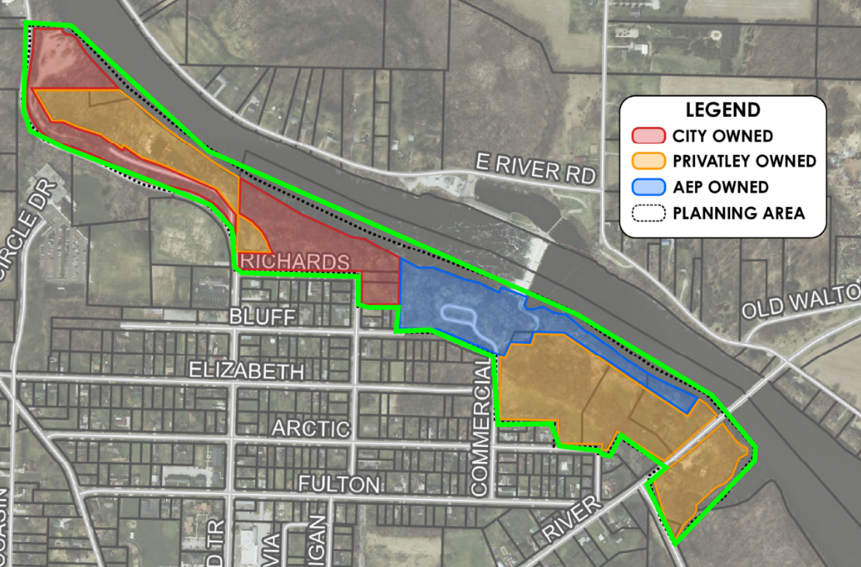
Project Site

Slide 4
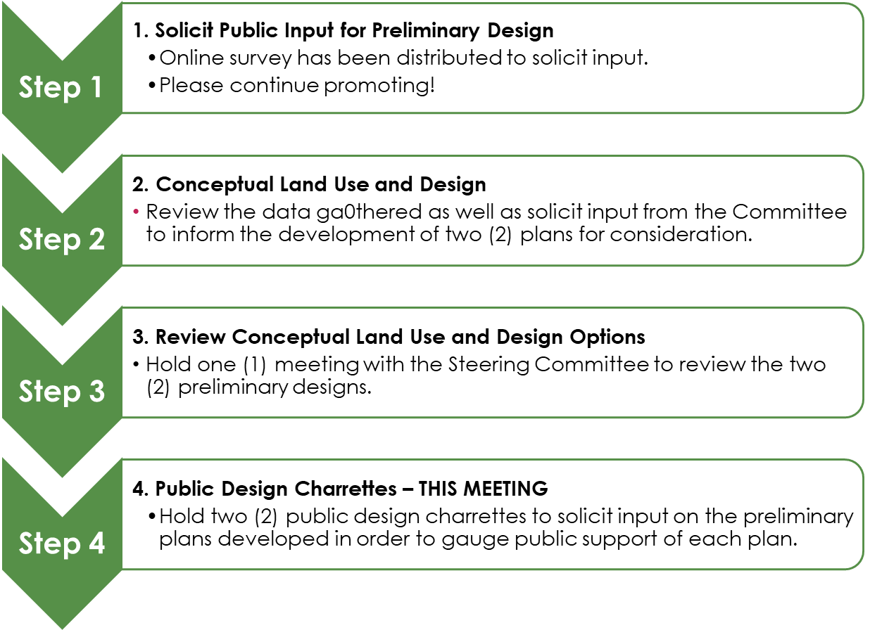
Master Plan Process

Slide 5
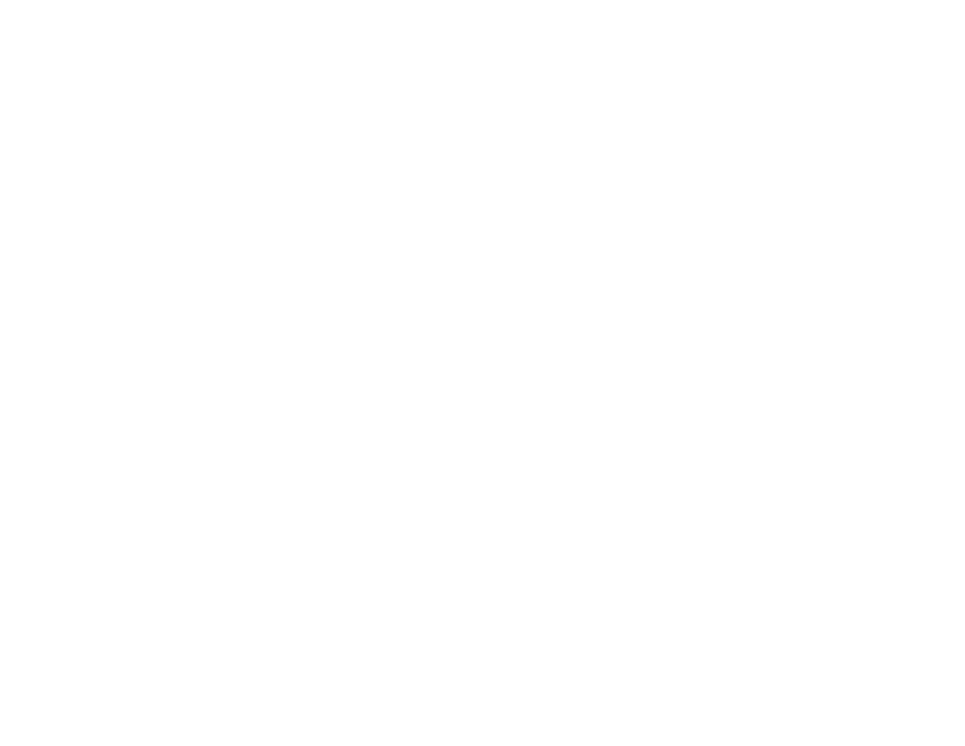
Master Plan Process
Step 5
Develop Final Plans for Consideration
Information collected through steps 1-4 will be used to develop two (2) preliminary plans for final consideration.
Step 6
Committee Review and Input
Review the final two (2) options with the Committee
Step 7
Finalize Waterfront Master Plan
The public feedback received in Step 6 will be used to finalize the two (2) preliminary plans for consideration. The two (2) plans will be presented to City Council to adopt a plan for moving forward.

Slide 6
Design Principals
Key guiding principals we used for design
(from survey and steering committee feedback)
Respect/protect natural areas
Retain natural feeling of the area
Restore connectivity to the St. Joseph River
Promote use of low-impact construction techniques
Connection to rest of the community
Kid/family/age/ability friendly
Access for all water sports (motor and people-powered)
Improve general maintenance
Include restrooms
Address safety issues
Explore the opportunity for a community boat house

Slide 7
Conceptual Design Review
1. Conceptual Design Overview to present the concept and connectivity of the area.
2. We will go back and focus in more detail on each section for feedback and discussion.
Materials
Existing Conditions for reference
Conceptual Layout
Example Amenity Sheet

