Slide 1
Downtown Real Estate Development Resources
SARAH SNOEYINK
Community Development Manger
Michigan Economic Development Corporation

Slide 2
Notes:
Economic Development Arm for the state of Michigan. MEDC has many resources to help developer tailored technical assistance for communities across Michigan. The MEDC has tools and resources to support businesses at any stage of growth. No matter your business size, industry, or your community needs, the MEDC’s many programs and local and regional partners have resources to help you.

Slide 3
MAKE IT IN MICHIGAN
Projects: Support Business through job growth in diverse sectors
Strengthen competitiveness in key priority sectors and ensure sustained, long-term growth in targeted industries to protect the state against potential economic downturns or recessions.
Become a top 10 state for small business growth, revenue growth, and venture capital funding.
People: Growing the Middle Class by empowering people and reducing barriers to increase incomes
Support increased labor force participation, training and upskilling, as well as inbound talent attraction.
Uplift 100,000 families out of working poverty and close equity gaps.
Support goal of 60% of adults with a postsecondary credential by 2030.
Places: Invest in Michigan’s community with high quality infrastructure that supports quality of life for all
Provide access to low or no cost childcare to 150,000 families.
Build or rehabilitate 75,000 housing units.
Connect every resident to high-speed internet.

Slide 4
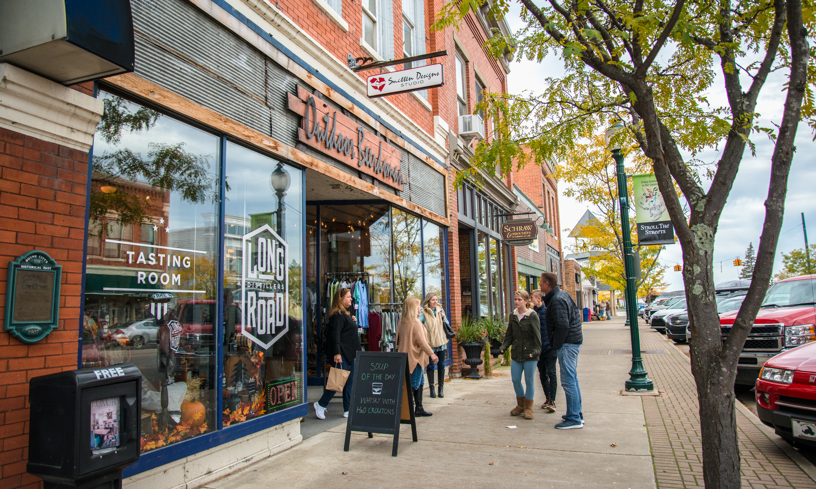
DEVELOPING ATTRACTIVE PLACES
Supporting the
growth of vibrant, diverse, and resilient communities across Michigan.

Slide 5
MEDC Real Estate Development Tools
Grants
Loans
Tax Increment Financing

Slide 6
MEDC Real Estate Development Tools
Grant programs can change year to year depending on the budget allocated by the legislature
Grant guidelines thus change too
Historically, grants maximums have been 50% of eligible expenses or $1.5m – whichever is less
Grants

Slide 7
MEDC Real Estate Development Tools
Loans are typically issued from the Michigan Community Revitalization Program (MCRP)
Loans are subordinated to a senior lender
Loans are issued at 1% interest
In Buchanan, maximum loan amounts are $10m or 50% of eligible project costs – whichever is less
Loans

Slide 8
MEDC Real Estate Development Tools
Tax Increment Financing (TIF) allows developers to be reimbursed over time for eligible up-front investments
Allows developer to address existing site conditions on properties that are historic, blighted, functionally obsolete or a facility
In Buchanan, MEDC eligible expenses include demolition, lead/mold/asbestos abatement, site preparation, and infrastructure improvements
Tax Increment Financing

Slide 9
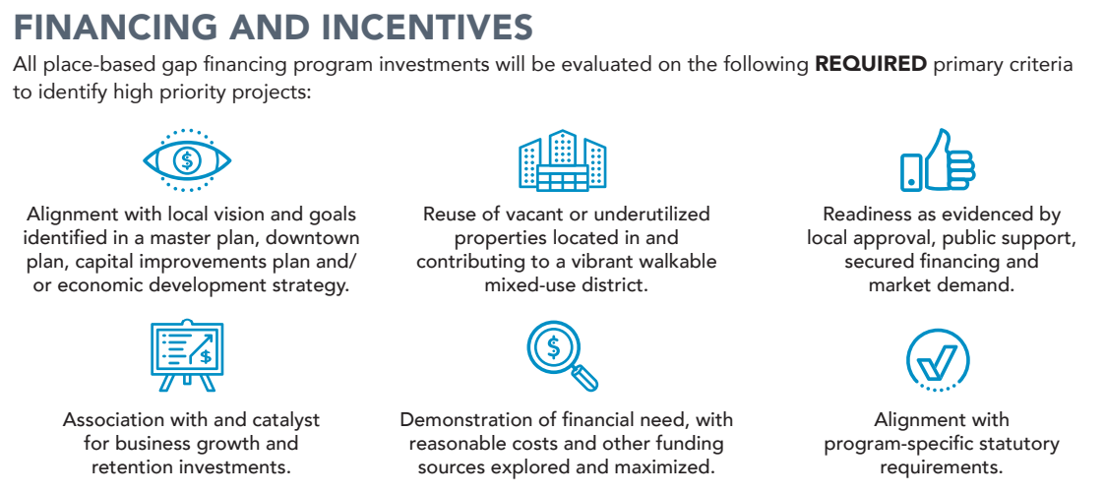
Is My Project a Good Fit for MEDC Funding?

Slide 10
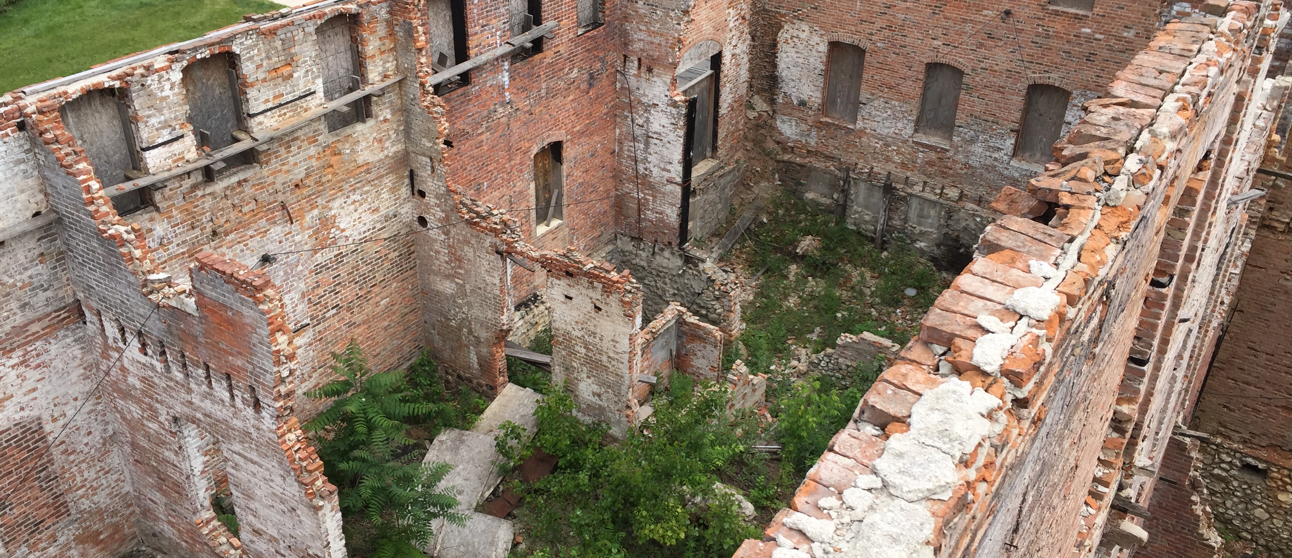
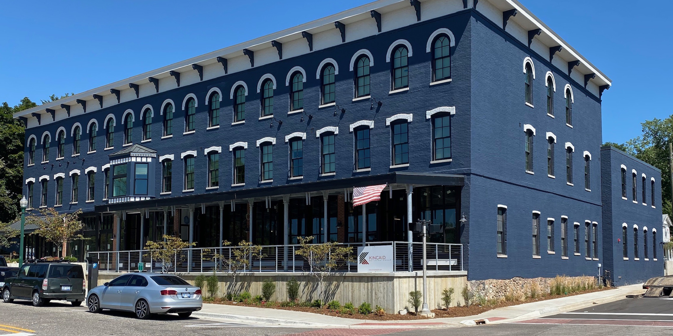
Is My Project a Good Fit for MEDC Funding?
Can You Answer “Yes” to These Questions?
Will the project fully activate a vacant or underutilized property within a quarter-mile of downtown? OR Will new construction in this side add vibrancy and density to downtown?
Will the project be commercial or mixed-use?
Is there a financial gap in the project?

Slide 11
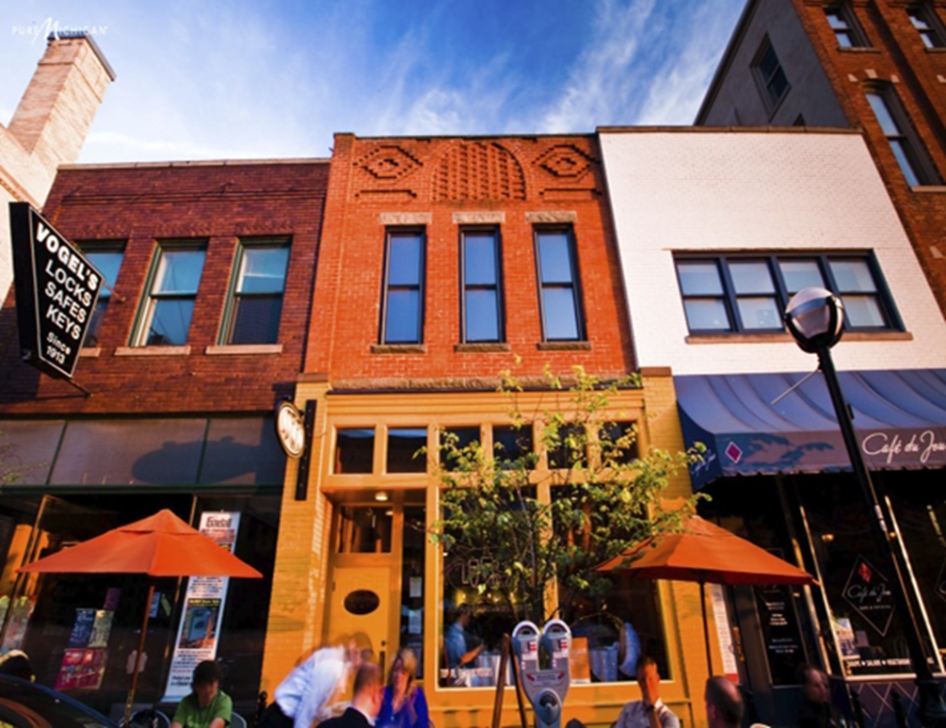
MEDC Application Process
Step 1: Connect with your community development manager
Step 2: Submit the preapplication packet
Step 3: Receive an LOI from the MEDC
Step 4: Submit a full application packet
Step 5: Receive final funding approval

Slide 12
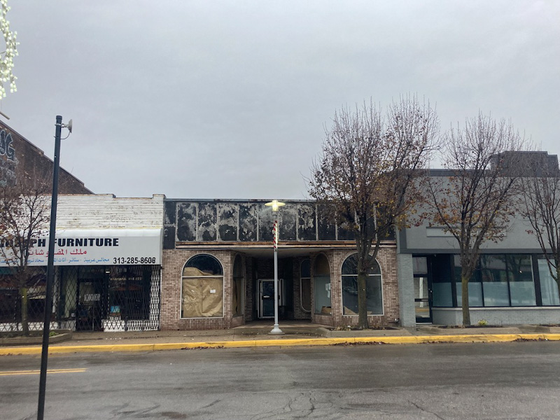
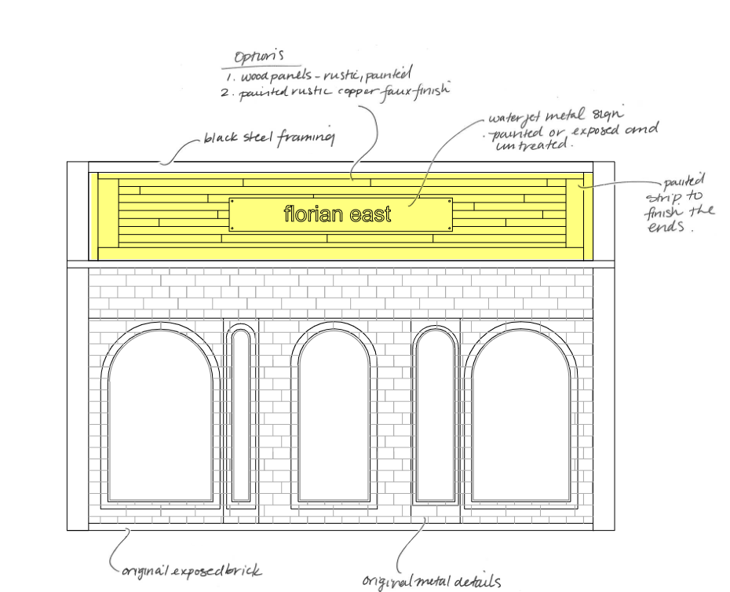
9350 Joseph Campau Avenue, Hamtramck
Notes:
Though smaller, can still do cool things
Microbrewery and tap room in Hamtrack
Owners equity 148,418 - 12.2% Building 150,000 - 12.3% DMCU fin 667,140 - 56% MEDC Ask 250,000 - 21% BMC Grant
Shilman Silk Shop LLC is a emerging development team of UofM law graduates who want to be a part of Hamtramck's growth to be more vibrant. A

Slide 13
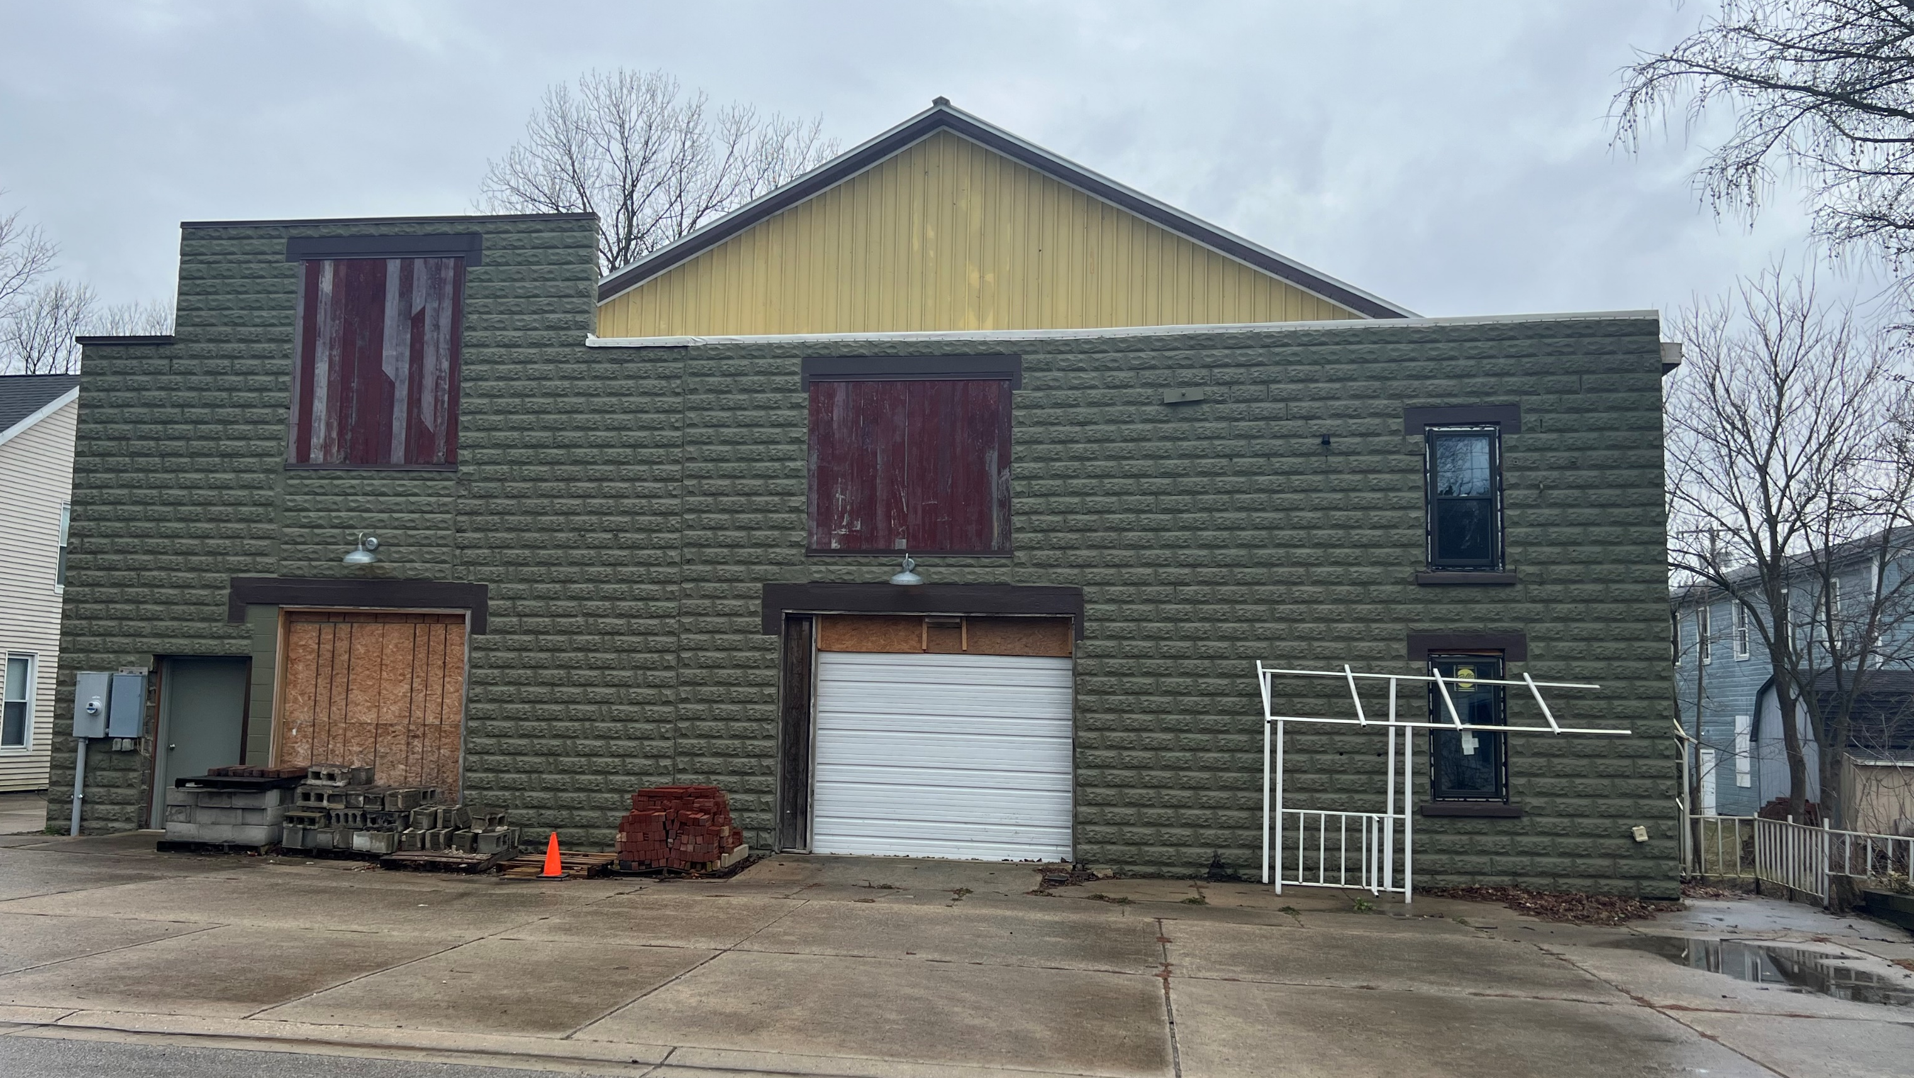
206 Days Avenue, Buchanan
Notes:
606 Days Avenue, LLC plans to redevelop an obsolete, vacant, multi-story building into a hospitality center which includes a first-floor restaurant space, outdoor-indoor event space, and 10 units of hotel lodging. The project will support the City of Buchanan’s efforts to activate properties along the Days Avenue Corridor. Upon completion, the project is projected to create 8 full-time positions and 7 full-time-equivalent positions. The project is expected to generate a total capital investment of $3.485 million, which is supported by a $1.25 million performance-based grant from the MEDC. The City of Buchanan is supporting the project through an Obsolete Properties Rehabilitation Act (OPRA) abatement.

Slide 14
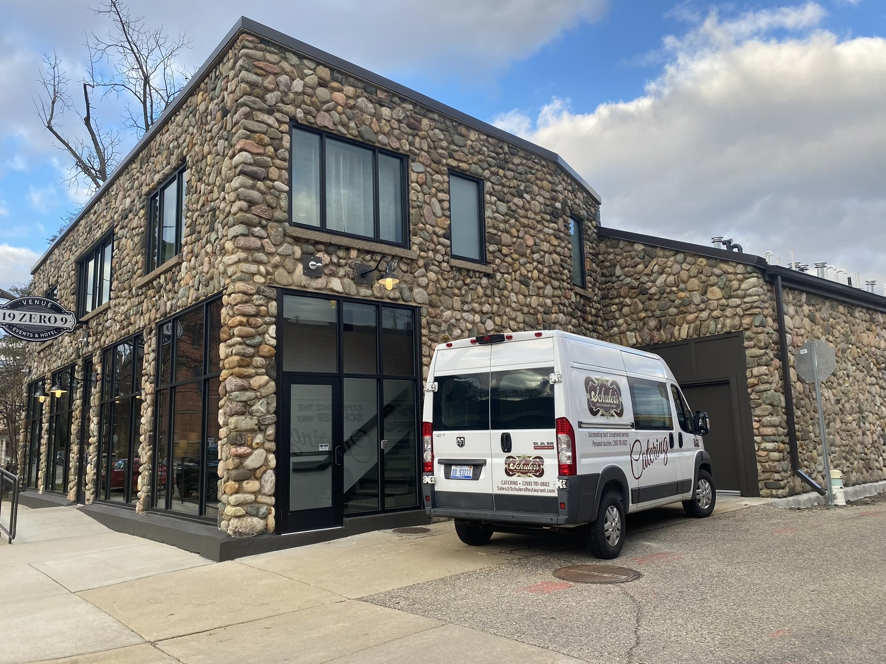
112 Eagle Street, Marshall
Notes:
Redevelopment of a long-vacant commercial building in downtown Marshall into an event space with three boutique hotel rooms; the project will be owned/operated by the same team that owns/operates Schuler's Restaurant in downtown Marshall. Total anticipated capital investment is $3,312,173.

Slide 15
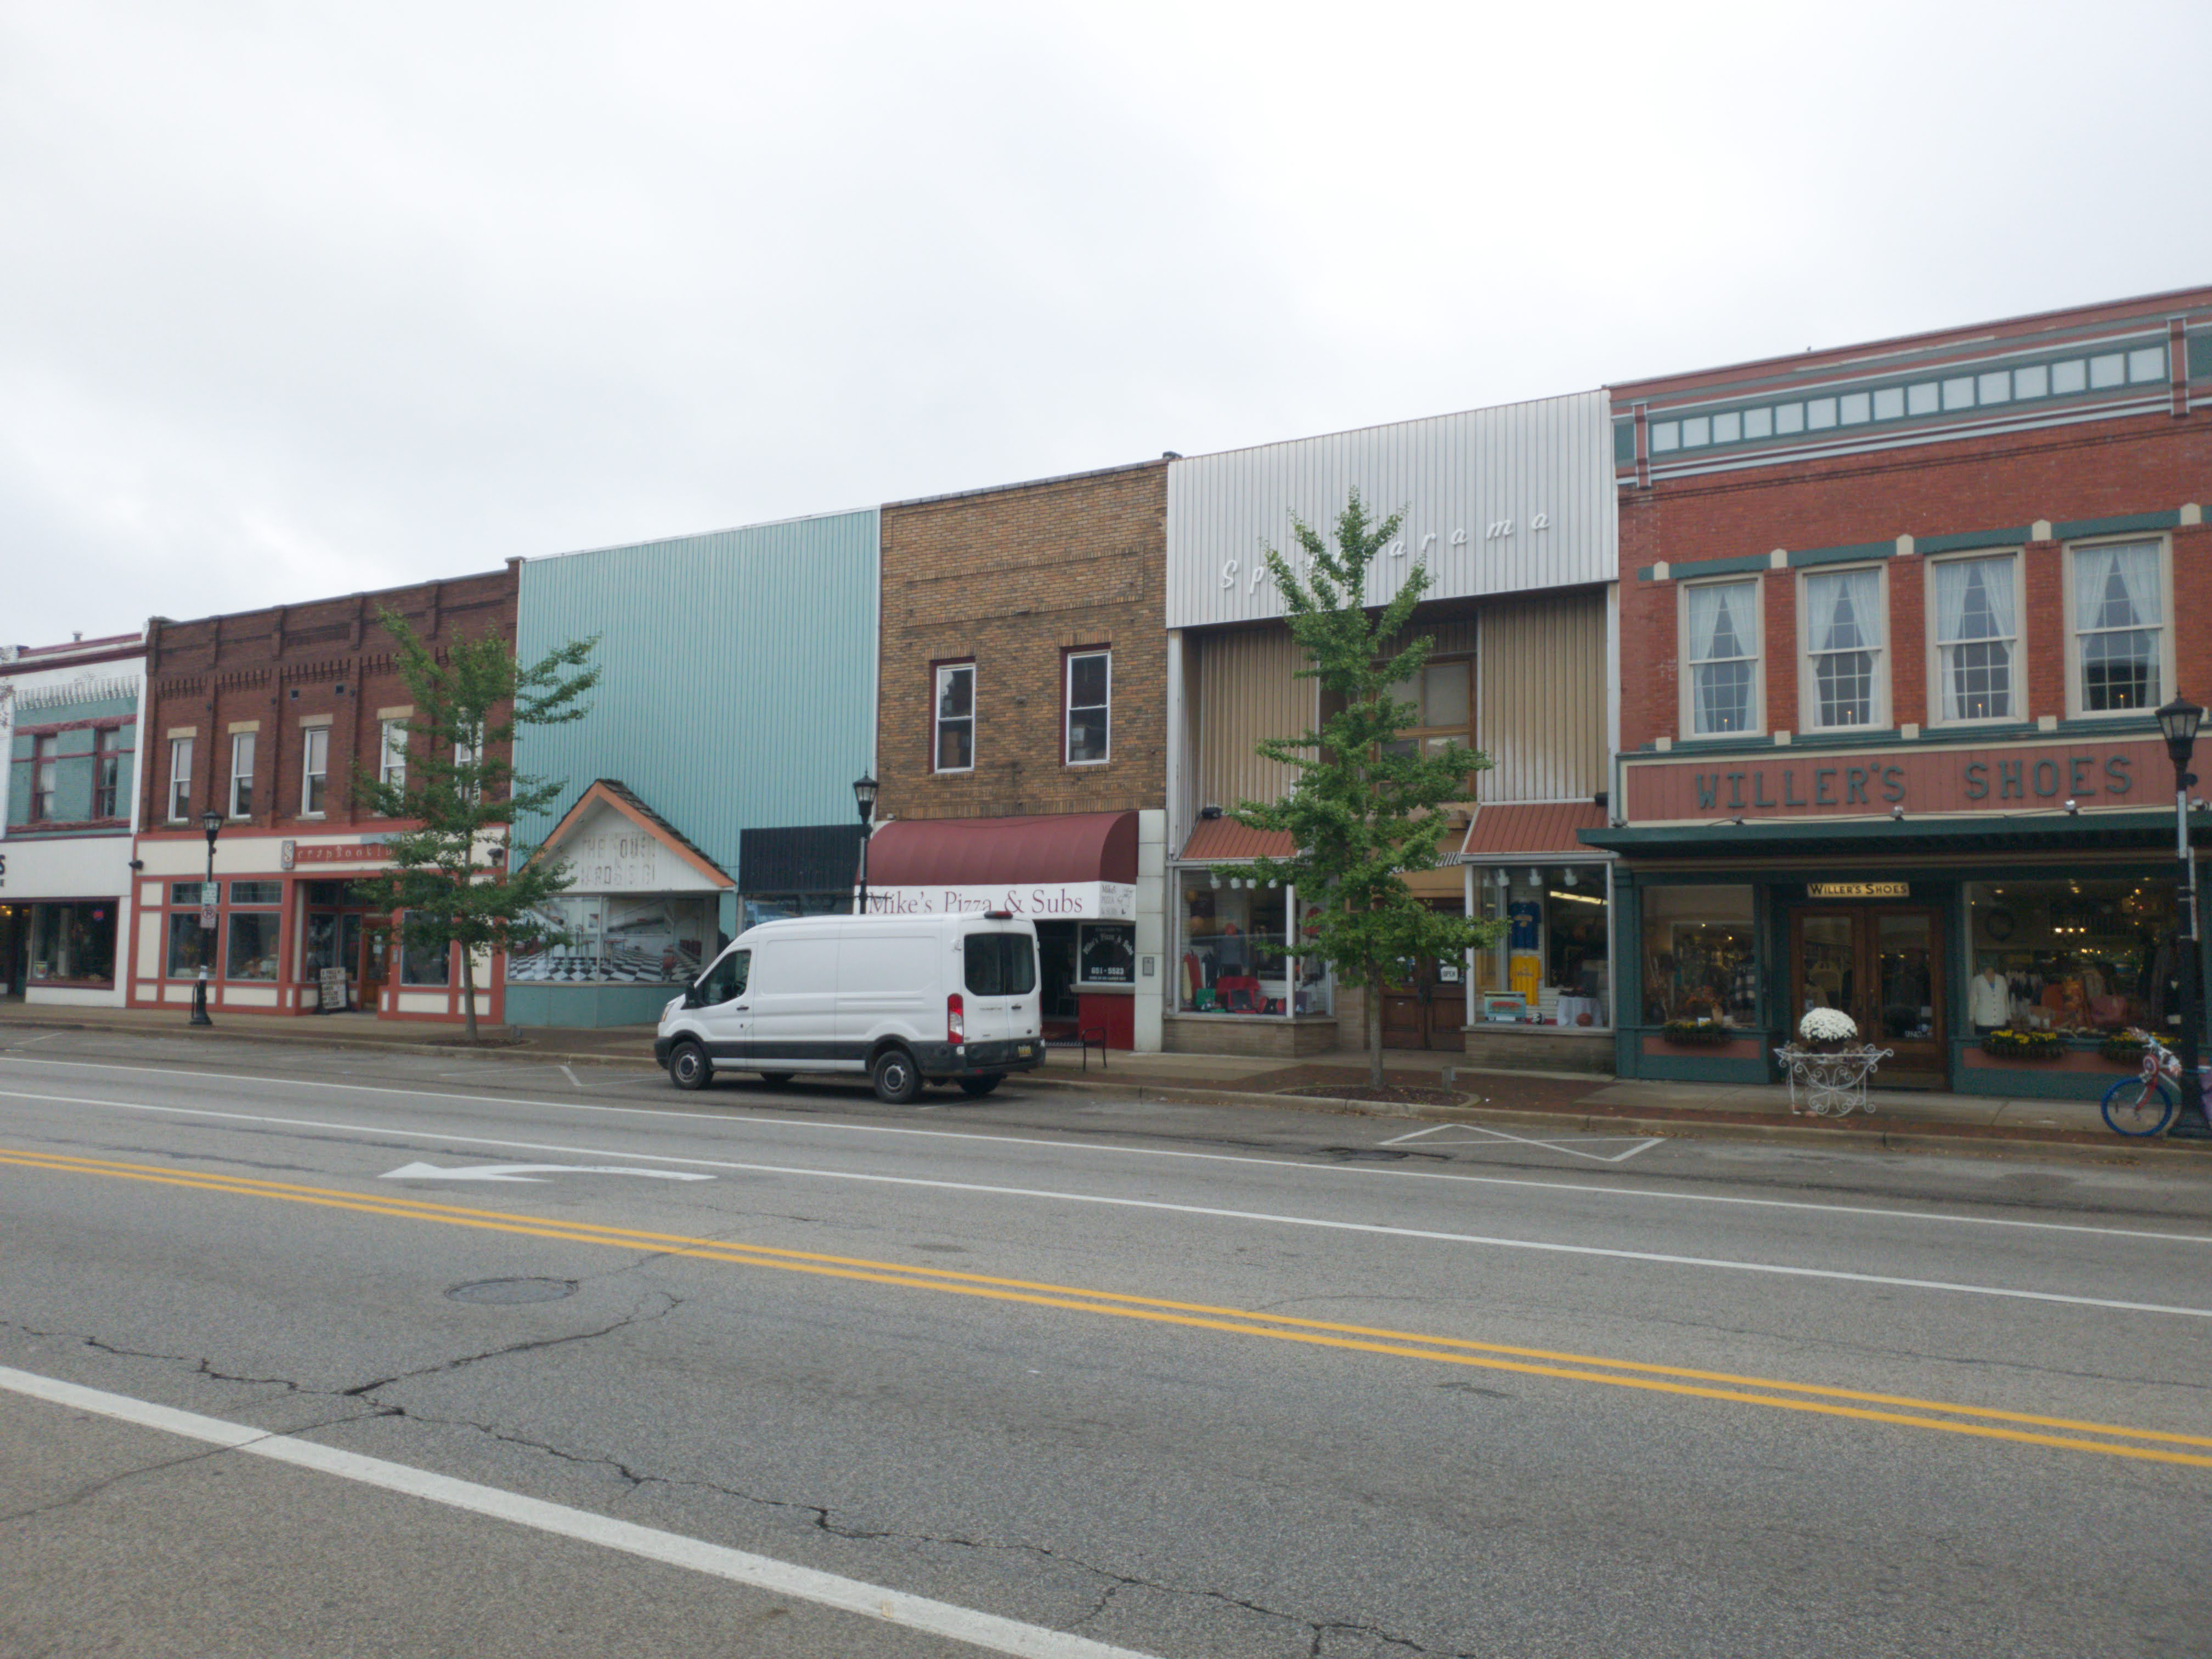
108 West Chicago Street, Sturgis
Notes:
The Watershed in Strugis
Demolished 3 buildings
Constructed five stories – 25+ RUs
TIF + CRP
$16M total, $4m CRP loan

Slide 16
Bonus Downtown Development Tools

Slide 17
Local Real Estate Development Tools
Obsolete Property Rehabilitation Act (OPRA): For contaminated blighted, functionally obsolete properties. Freezes taxes for 12 years.
Commercial Rehabilitation Act (PA 210): Rehabilitation in a city, village or township. Property taxes generated from new investment are abated for 10 years.
Commercial Redevelopment Act (PA255): Replacement, restoration, or new construction of commercial property in city or village. Property taxes generated from new investment are abated for 12 years.
Local
Tax Abatements

Slide 18
MEDC Capital Access Tools for Small Businesses
The MEDC’s small business team has a variety of capital access tools available to support the capital needs of growing businesses:
Collateral Support Program: The program will supply pledged cash collateral accounts to lenders to achieve this goal for approved projects.
Loan Participation Program: The Loan Participation Program seeks to enable companies to acquire the necessary financing that might otherwise be unavailable due to a cash flow shortage according to the lender’s analysis. The program will participate by purchasing a portion of the loan from the lender for approved projects.
Loan Guarantee Program: The program help mitigates a portion of the risk associated with small business lending by providing a partial guarantee to a qualified lender.

Slide 19
